Slide 1

Coffee Cup Sales Analysis for 2018 and 2019
By
Osahon P. Ize-Iyamu
December 2022

Slide 2
Table of Content
Data Cleaning
Executive Summary
Detailed Analysis
Recommendations
Business Questions I – What Data Could Answer
Business Questions II – What Data Could Not Answer
Strategy Map

Slide 3
Data Cleaning
Data Cleaning Issues
S/N | Column Name | Description | #Rows | % | Remarks
1 | Budget COGS | Number of “Zeros” | 82 | 2 | Ignored in analysis
2 | Budget Sales | Number of “Zeros” | 24 | 1 | Ignored in analysis
3 | Budget Profit | Number of “Zeros” | 152 | 4 | Ignored in analysis
4 | Marketing | Number of “Zeros” | 66 | 2 | Ignored in analysis
5 | COGS | Number of “Zeros” | 66 | 2 | Could not be optimized. May impact computations for Net Margin and Gross Margin
6 | Profit | Number of “Zeros” | 32 | 1 | Could not be optimized. May impact computations for Net Margin and Gross Margin
7 | Inventory | Negative values | 88 | 2 | Ignored in analysis
8 | Date | (a) Not in a date format (b) The year 2012 has incomplete data on products. 2013 to 2017 were missing |  |  | (a) Transformed to date format using Tableau. (b) 2012 was ignored in analysis
Tools:
Python: To detect “null values”
SQL: To sort “zeros”
Tableau: To transform the Date Column to the appropriate date format
There are 4248 rows and 20 columns in the dataset. The dataset gives insights into sales and profits across all provinces and territories in Canada. It covers sales activities for 2012, 2018, and 2019. Total of 102 stores

Slide 4
Ice Breaker
Profit!
What does this mean
1
2
3
Top Executive &
Senior Management
Employee
Shareholders
Bonus/Salaries/Dividend
Salaries/Wages
Dividend

Slide 5
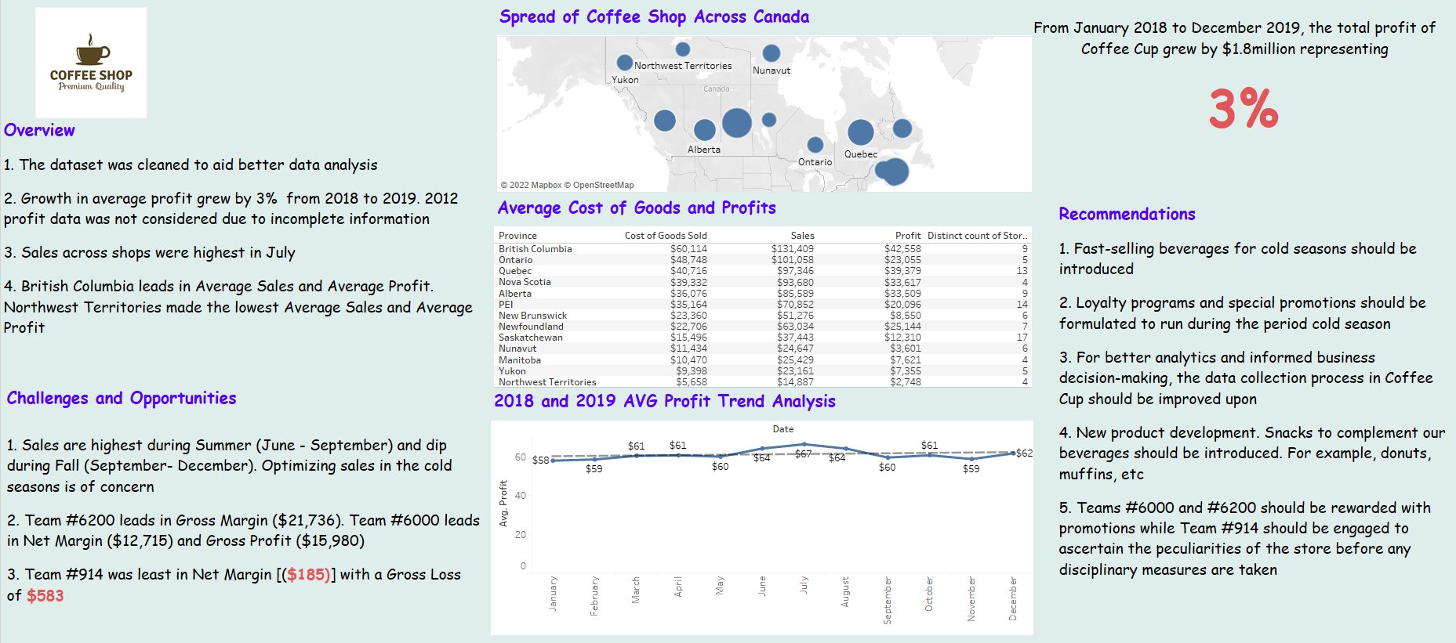
EXECUTIVE SUMMARY: COFFEE CUP SALES ANALYSIS FOR 2018 AND 2019

Slide 6
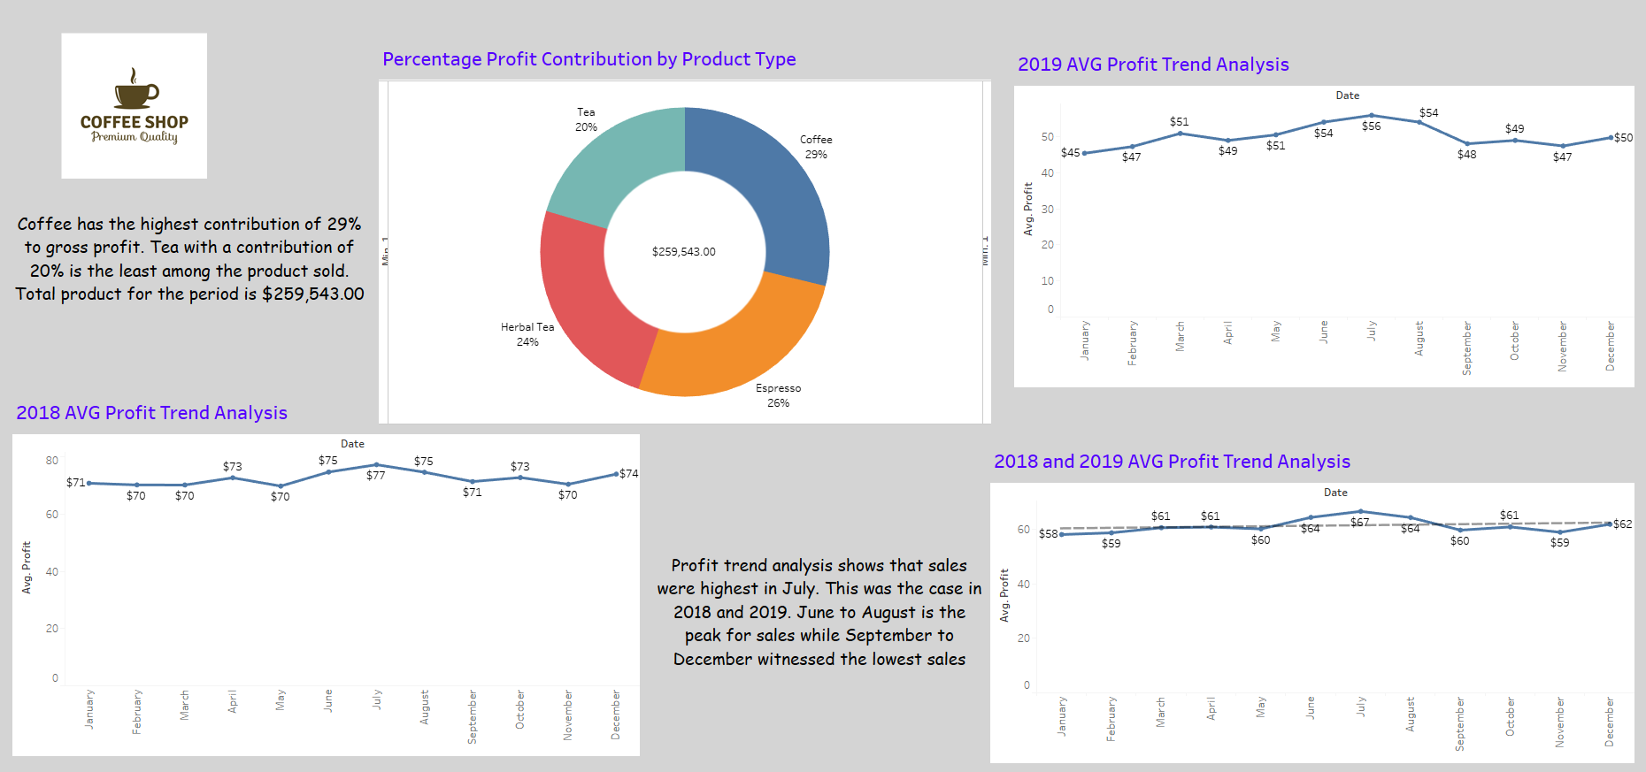
Trend Analysis of Profit from 2018 to 2019

Slide 7
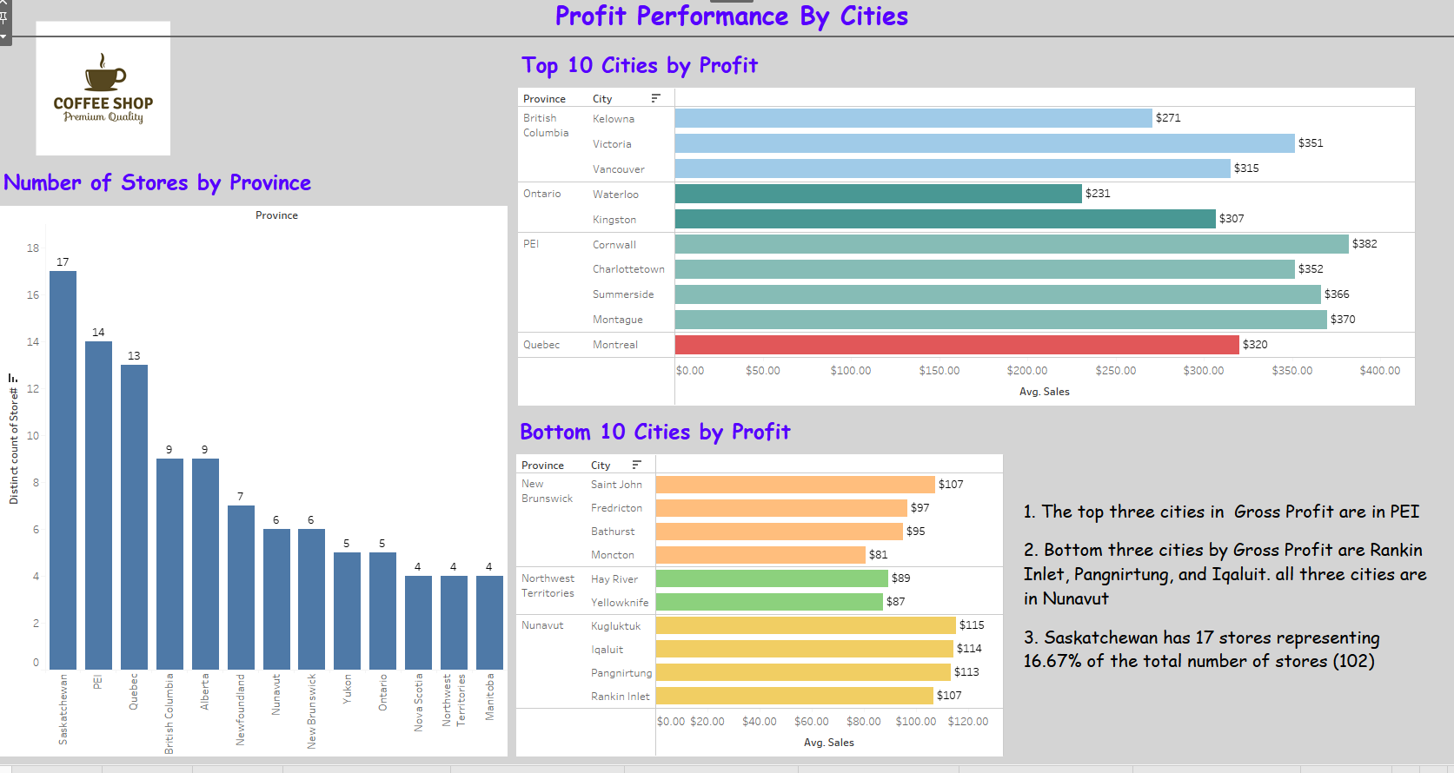
Profit Performance By Cities

Slide 8
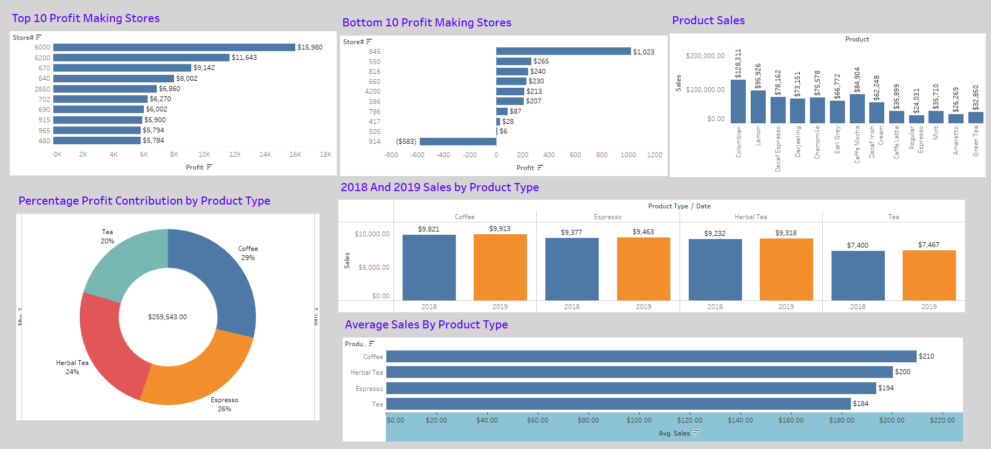
2018 & 2019 Sales and Profit Analysis

Slide 9
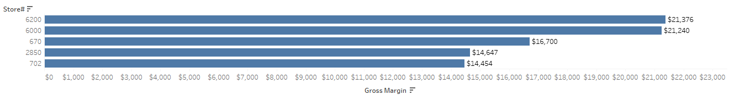
Gross Margin – Top 5 Stores
Store #6200 leads with $21,376

Slide 10
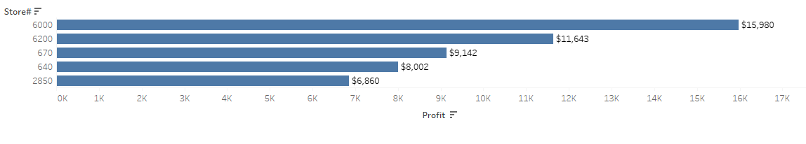
Gross Profit – Top 5 Stores
Store #6000 leads with $15,980

Slide 11
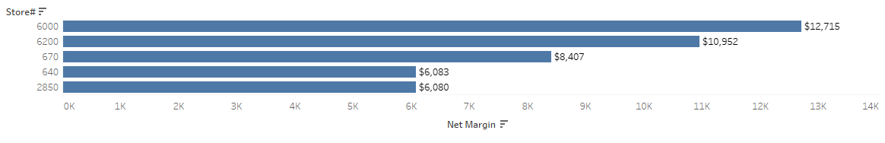
Net Margin – Top 5 Stores
Stone #6000 leads with $12,715

Slide 12
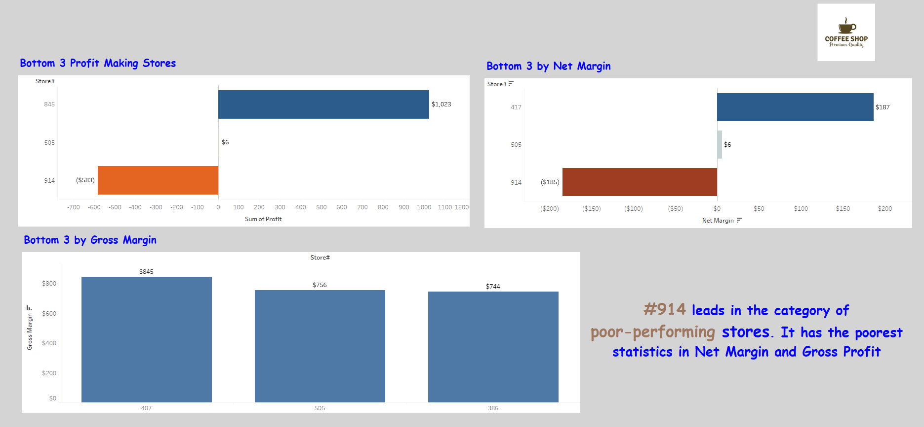
Poor Performing Stores

Slide 13
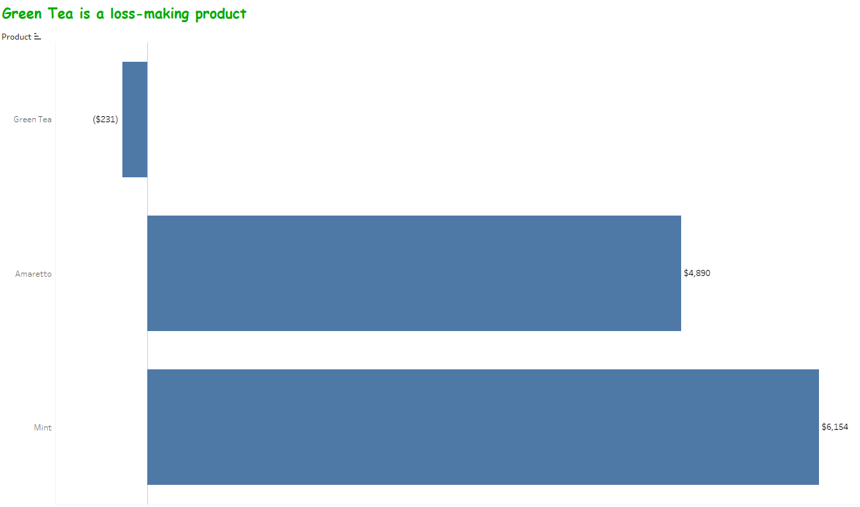
Recommendations
We are making losses from Green Tea; hence it should be dropped from our menu.
Complimentary products should be introduced to help improve sales. Products like donuts and muffins can be consumed together with tea, coffee, etc.
Introduction of chocolate drinks (hot and cold variants) is also recommended
Growth Strategy: (1) Loyalty programs and promotions should be well-defined for the peak season (Summer) and off-peak season (Winter). (2) More stores should be established in BC. (3) Product diversification (complementary products)
For better analytics and informed business decision-making, the data collection process in Coffee Cup should be improved upon
Teams #6000 and #6200 should be rewarded with promotions while Team #914 should be engaged to ascertain the peculiarities of the store before any disciplinary measures are taken

Slide 14
Business Questions I – What Data Could Answer
S/N | QUESTIONS | S/N | QUESTIONS
1 | Peak season | 11 | Most Profitable City – Net Margin
2 | Off-peak season | 12 | Number of Stores - Province
3 | Most Profitable Province – Gross Profit | 13 | Number of Stores - City
4 | Most Profitable Province – Gross Margin | 14 | Growth in Profit from 2018 to 2019
5 | Most Profitable Province – Net Margin | 15 | Product Percentage Contribution to Gross Profit
6 | Most Profitable Store – Gross Margin | 16 | Product Percentage Contribution to Net Margin
7 | Most Profitable Store – Net Margin | 17 | Product Percentage Contribution to Gross Margin
8 | Most Profitable Store – Gross Profit | 18 | Less populated provinces have more stores than more populated provinces
9 | Most Profitable City – Gross Profit | 19 | Most Performing Stores, Cities & Province (Profitability)
10 | Most Profitable City – Gross Margin | 20 | Least Performing Stores (Profitability)

Slide 15
Business Question II – What Data Could Not Answer
Why do Saskatchewan and PEI have more stores than British Columbia and Ontario?
Why are data for 2013, 2014, 2015, 2016, and 2017 missing?
When were sales promotions done to ascertain effects on sales?

Slide 16
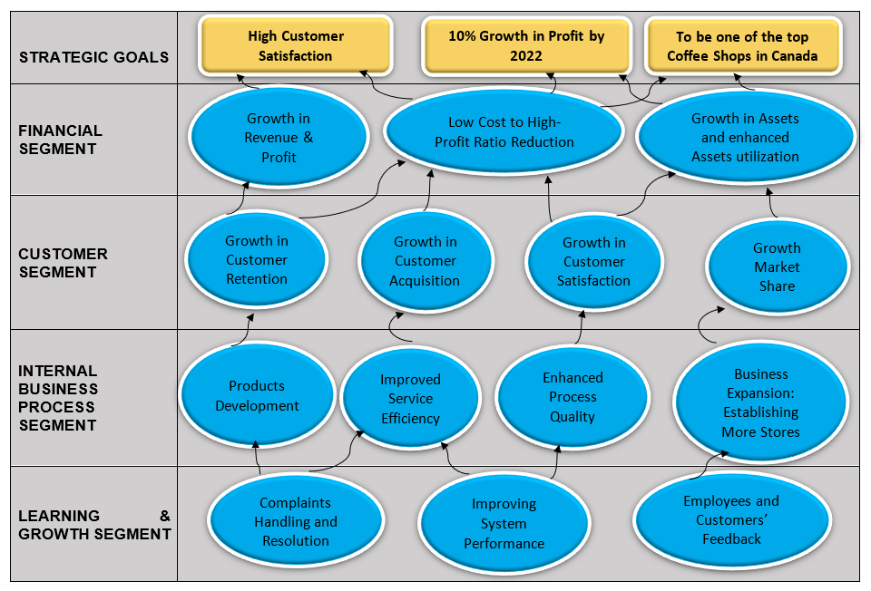
Strategy Map

Slide 17
THE END

